Slide 1

Understanding The People’s Budget
The People’s Budget Campaign American Friends Service Committee
Coalition on Human Needs
Daily Kos
Economic Policy Institute
National Alliance of HUD Tenants
National Priorities Project
Peace Action
People Demanding Action
People’s Action
Progressive Congress
Progressive Democrats of America
Social Security Works
US Labor Against the War

Slide 2


Introduction and Welcome
Andrea Miller, Executive Director
People Demanding Action
Call Structure and Norms:
Audio is PHONE ONLY; you must call in
Do not enable your video camera
All calls are recorded; the recording link will be posted on the Discussion
Q & A mode: To eliminate background noise we mute everyone when we begin recording.
Press *6 (when prompted) to ask a question; say your name, your organization, if any, and location. Be courteous and brief; give others a chance to ask questions too.
Download this Presentation: http://www.peoplesbudget.org/index.php/downloads/fy2018-people-s-budget

Slide 3


Technical Information
Audio is available only via phone
DIAL IN: 712-770-4160 ACCESS CODE: 781761#
Meeting Room Functions
- Chat
- Share
Use the Share button in the Meeting Room:
After the call, click the unique link below to download this week's PowerPoint, recording link and other materials: http://www.peoplesbudget.org

Slide 4
Speakers
Dr. Gabriela Lemus, Executive Director, Progressive Congress
Debbie Weinstein, Coalition for Human Needs
Cole Harrison, Peace Action
Michael Kane, National Alliance of HUD Tenants
Paul Shannon, American Friends Service Committee

Slide 5
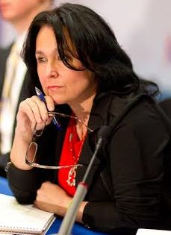
Dr. Gabriela Lemus, Progressive Congress
Since September 2013, Dr. Gabriela D. Lemus has served as the President of Progressive Congress. Dr. Lemus served as Senior Advisor to Secretary of Labor Hilda L. Solis and was Director of the Office of Public Engagement from July 2009 until August 2013. Prior to her appointment, she was the first woman to hold the position of Executive Director at the Labor Council for Latin American Advancement (LCLAA) from 2007-2009, and the first woman to chair the National Hispanic Leadership Agenda (NHLA) from 2008-2009. During her tenure at LCLAA, she helped co-found the National Latino Coalition on Climate Change (NLCCC) and was a Commissioner for the Commission to Engage African-Americans on Climate Change (CEAAC). She served 3-year terms on the advisory boards of both the Washington Office on Latin America (WOLA) from 2005-2008 and the United States Labor Education in the Americas Project (USLEAP) from 2006-2009. In January 2013, she was confirmed by the DC Council to sit on the Board of Trustees of the University of the District of Columbia.

Slide 6
Topics Tonight
Infrastructure
Climate/Environment
Human Needs
  Safety Net
  Education
  Housing
Military Spending
How You Can Help Us Move the People’s Budget Forward/Resources

Slide 7
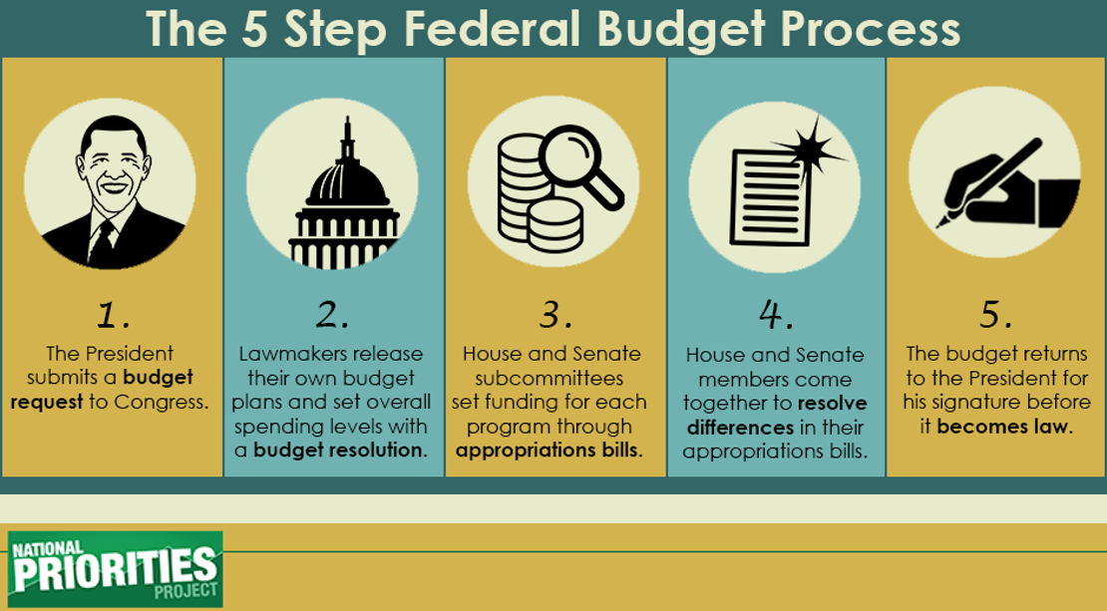
The 5 Step Federal Budget Process

Slide 8
$2 Trillion Plan for Infrastructure in the People’s Budget
Transitions to 21st Century Infrastructure
20 percent of major roads in the United States are considered to be in poor condition.
United States ranks 16th globally for quality of infrastructure, according to the World Economic Forum.
Commitment to Clean Drinking Water Pipes
Invests $350 Billion to replace aging drinking water pipes
Prioritizes communities with the greatest need

Slide 9
$2 Trillion Plan for Infrastructure in the People’s Budget
Smart Grid Technology
Invests $500 Billion to update the energy grid
Creates millions of green, renewable jobs
Ensures transition to 100% renewable energy by 2050
Supports Public Transportation and Commuter Benefits
Robust investment in public transportation network, including passenger rail, buses, biking and walking paths

Slide 10
$2 Trillion Plan for Infrastructure in the People’s Budget
Expanding Broadband to Support Rural Businesses and
Communities
Ensure our schools, libraries, and other
centers of civic life are adequately “future-proofed”
Supports the FCC’s successful “E-Rate” program, which supports broadband internet in rural, small town, and underserved urban schools
Rebuilding Public Schools
Invests $75 billion to repair and modernize our schools
Provides Direct Funding to Communities

Slide 11
Protecting Our Environment
“The only budget in Washington that truly accepts the urgency of the climate crisis.” Lukas Ross, Friends of the Earth
Bold Investment in Green Jobs
Impose a Price on Carbon Pollution
Eliminate Corporate Welfare for Oil, Gas and Coal Companies
Helping Communities Adapt
Reinstate Superfund Taxes
Crop Insurance Subsidies

Slide 12
Eliminate Corporate Welfare for Oil, Gas and Coal Companies
The CPC Budget repeals approximately $135 billion in fossil fuel subsidies over 10 years. The fossil fuel industry enjoys dozens of permanent subsidies thanks to decades of successful lobbying. Just one of these loopholes, the “percentage depletion allowance,” will cost taxpayers $17 billion over the next decade. Researchers at the International Monetary Fund found that in 2015 fossil fuel subsidies (including both tax breaks and the cost of health and environmental externalities) cost $5.3 trillion – or $10 million a minute.

Slide 13

Impose a Price on Carbon Pollution
The People’s Budget implements a $25 per ton price on carbon dioxide emitted by polluters (increasing at 5.6 percent a year) and rebates 25 percent of all revenues to protect low income families from any rising energy costs via refundable credits. Revenue from this carbon price will be used to fund renewable energy and energy efficiency development and deployment. The Energy Information Administration found that a similar proposal would result in carbon emissions reductions of 26 percent below 2005 levels by 2020. This will go a long way toward setting the United States on a path to minimize the dangers of climate change, particularly when combined with air pollution control measures, increased energy efficiency and renewable energy deployment.

Slide 14
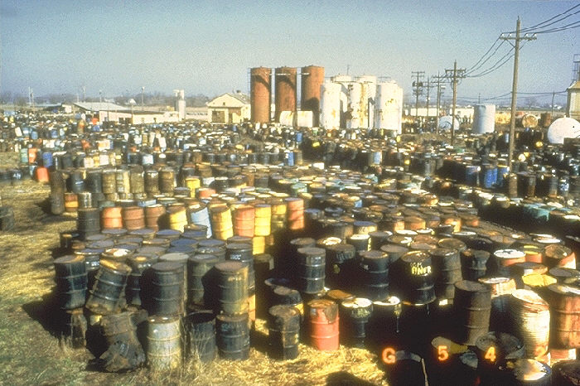
Reinstate Superfund Taxes
Our budget reinstates the Superfund excise taxes that expired in 1995. The Environmental Protection Agency’s Superfund program, once largely funded by dedicated taxes, is now funded primarily by general revenue. Having a stable source of funding, rather than relying on year-to-year appropriations, will provide $22 billion more for cleanup of hazardous and contaminated land, often located in disadvantaged communities.

Slide 15
Helping Communities Adapt
The People’s Budget increases funding for EPA climate adaptation programs and FEMA climate resiliency initiatives. It also incorporates the job training and economic development funding outlined in the President’s POWER plus plan to assist displaced fossil fuel workers and communities impacted by changing energy policies.

Slide 16

Crop Insurance Subsidies
The CPC Budget reduces the federal government’s subsidy from 60 percent to 40 percent premiums, on average. Insurance policies purchased through the program are sold and serviced by private insurance companies, which are reimbursed by the federal government. In 2013 the Congressional Budget Office predicted that crop insurance will cost taxpayers $88 billion over the course of a decade.

Slide 17
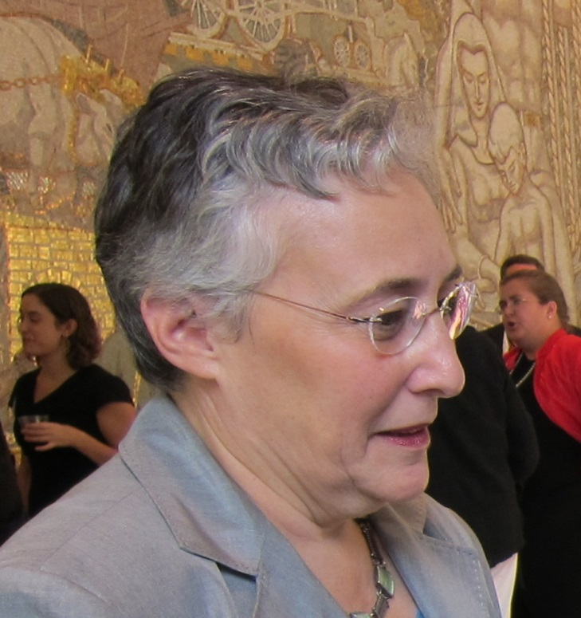

Deborah Weinstein
Executive Director,
Coalition on Human Needs,
www.chn.org
  An alliance of national organizations working together to promote public policies which address the needs of low-income and other vulnerable people.

Slide 18
The Problem:
Too Many Poor or On the Edge
In poverty:
  43 million people
  (below $24,000, family of 4)
  Nearly 1 in 5 children
    30% of Latino children
    36.5% of African American children
On the edge:
  Nearly 1/3 live below 2x the poverty line

Slide 19
The People’s Budget’s Solution
Invest and Protect:
  $2 trillion investment in rebuilding America – creates millions of jobs.
  Protects and expands health care, nutrition and housing assistance, tax credits
  Invests in children
  Protects retirees

Slide 20
Health Care
Improves care and saves $:
  Replaces excise tax on high-cost plans with public option (net savings, $116b)
  Medicare: negotiate drug prices (saves $430b)
  Extends CHIP through 2019

Slide 21
On the other hand, Trump
  Cuts $1.3 TRILLION from Medicaid:
    ACA Repeal
    Even deeper cuts through block granting/per capita capping
    23 million lose health insurance…and counting

Slide 22
Nutrition Assistance
  Restores SNAP/food stamps: (+$21b over 10 years)
    Reverses cuts that reduced benefits by $127 per person in 2016.
    Ends 3-month time limit for unemployed childless adults.
    Improves child nutrition programs

Slide 23
On the other hand, Trump
  Cuts $193 billion from SNAP:
  Applies more stringent work requirements (code: roadblocks to aid)
  Applies 3-month limit to more unemployed childless adults.
  Will require up to 25% match from states; will let them reduce benefits.

Slide 24
Child Care and Early Learning
  Major child care initiative:
    $993b over 10 yrs. to limit child care costs to no more than 10% of family income.
    $48b to improve child and dependent care tax credit.
    Preschool for All: $73b.

Slide 25
Supports for Workers
  Restores Unemployment Insurance:
  99 weeks of Emergency Unemployment Compensation
  Improves UI extended benefits
  Expands Earned Income Tax Credit for workers without dependent children
    (would prevent 800,000 from being taxed into poverty)
  Paid sick leave, paid leave (fed employees)

Slide 26
On the other hand, Trump
  Cuts $40 billion from EITC and child tax credit:
  Immigrants will lose Child Tax Credit; some workers will lose EITC.
  Paid leave, but limited.

Slide 27
Supports for Retirees
  Strengthens Social Security:
    Higher cost of living increases
    Caregiver credit (for people who take time away from paid work to care for children or other family members)
    Removes cap on SS contributions
  Retirement benefits for veterans and federal retirees indexed to CPI for elderly households

Slide 28
More…
  Comprehensive immigration reform:
    Will save $197b over 10 years
    No border wall; no enforcement at sites such as schools, religious institutions, courthouses, etc.
    DACA young people protected
  More funding for opioid/substance abuse treatment
  Half in Ten commitment
  10-20-30 antipoverty targeting

Slide 29
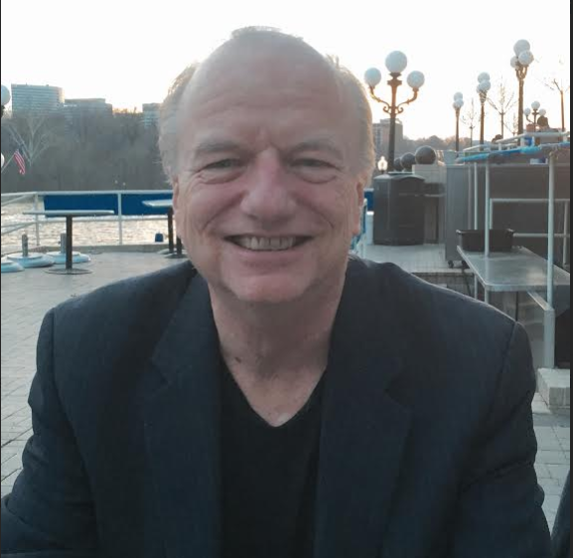
Michael Kane, National Alliance of HUD Tenants
Michael Kane has served as the Executive Director of the National Alliance of HUD Tenants since 1994. NAHT is the national union representing the 1.7 million tenants in privately-owned, HUD subsidized multifamily housing, and is the only national tenants union in the US. Kane has also organized HUD tenants in Massachusetts with the Mass Alliance of HUD Tenants since 1983, helping tenants save 12,200 apartments as affordable housing, one building at a time, through tenant organizing. Kane also served on the Board of the Habitat International Coalition (HIC), the leading global housing rights network, from 2004 through 2014, including a term as Vice President.

Slide 30
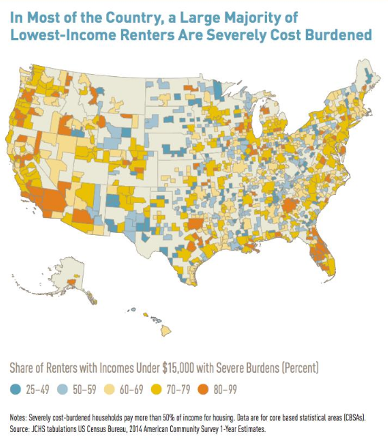
Access to Housing/Eliminating Homelessness
Currently, only 25 percent of qualifying families in need of housing assistance are receiving this essential benefit. In order for families to reach the middle class, home ownership must be within reach. The CPC Budget funds and supports programs to end family homelessness and the affordable housing crisis
Increased Funding for Community Development Block Grants and HOME Program
Sustain and rebuild public housing
Funds Housing for Seniors and People with Disabilities
Restores full funding for Section 202 housing for low income seniors and
Section 811 housing for people with disabilities
Funds 400,000 new Housing Choice Vouchers

Slide 31
Access to Housing/Eliminating Homelessness
Ends family homelessness
Funds Rep. Waters’ Ending Homelessness Act and provides $12.8 billion for several different federal programs and initiatives designed to bring homelessness in this country to zero through the creation of over 400,000 housing units
Funds 25,000 new permanent supportive housing units and assist 8,000 families with rapid rehousing
Provides robust funding for Low Income Heating Assistance

Slide 32
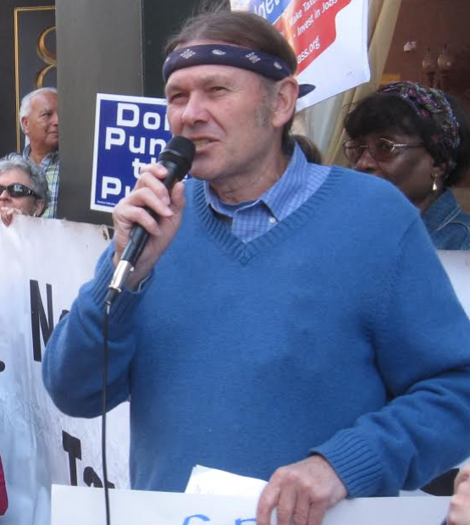

Paul Shannon
Paul Shannon is on the staff of the American Friends Service Committee in Cambridge, Massachusetts and a Coordinator of the Massachusetts Budget for All Coalition

Slide 33
Military spending in the Peoples Budget
Pentagon spending has doubled over the last decade at the expense of investments in working families. As President Trump expands the endless, unauthorized war against the Islamic State and al-Qaeda affiliates in Syria, Iraq, Yemen, and the broader Middle East and advocates for an irresponsible $54 billion boost in spending to an already bloated Pentagon budget, the The People’s Budget continues to stand in stark contrast to these misguided efforts.
The People’s Budget prohibits any expansion of U.S. combat troops in Syria, prohibits
an increase in defense spending and slashes wasteful Pentagon spending
The People’s Budget also increases funding for diplomacy, sustainable development, and humanitarian assistance to address the ongoing crises in Syria, Iraq, Yemen, South Sudan, Nigeria and many other countries around the world.
The Congressional Progressive Caucus does not support Pentagon cuts mandated by sequestration
Ends Emergency War Funding in FY2018 - Ends the Overseas Contingency Operations (OCO) altogether and saves $852 billion compared to current law

Slide 34
Military spending in the Peoples Budget
Reduces Base Pentagon Spending
The People’s Budget redirects funding to priorities such as caring for our veterans, Congressional Directed Medical Research Programs (CDMRP), smart diplomacy, and environmental cleanup and climate change mitigation programs within the DOD Strategic Sustainability Performance Plan
Our budget increases investments in DOD’s Office of Economic Adjustment to assist state and local governments to respond to major defense program shifts by helping communities adjust to defense contract losses

Slide 35
Military spending in the Peoples Budget
The People’s Budget reins in excessive CEO pay for defense contractors, reduces the proportion of private contractor personnel by transitioning
their work to civilian personnel, and curbs needless “outsourcing” that creates excessive cost overruns
Additional reforms include the decommissioning of our Cold War-era nuclear weapons infrastructure, as outlined by the Smarter Approach to Nuclear Expenditures (SANE) Act
Audit the Pentagon - The Pentagon loses tens of billions of dollars annually as highlighted by several GAO reports and a 2015 study from the
advisory Defense Business Board (DBB), which identified $125 billion worth of administrative waste

Slide 36
Why the Peace Movement Should Support The People’s Budget
We should support of the Peoples’ Budget for 2 reasons:
First, its Pentagon cuts are larger and more significant in terms of stopping wars than in any other budget proposal. Pentagon cuts is the most difficult section of the People’s Budget for CPC members to “sell” to other members of Congress and even to CPC members. If we in the peace movement want deeper cuts, it is up to us to create the conditions that make deeper cuts politically feasible
This CPC budget can serve as a vehicle that allows us to work on a common project with climate, social and racial justice movements who should be attracted to its bold increases in funding for all the programs the country needs

Slide 37

Q&A – Endorsing Organizations
Peace Action
National Alliance of HUD Tenants
Coalition for Human Needs

Slide 38
Education for All
The People’s Budget invests in our students by providing robust early learning opportunities, effective 21st century public schools and debt-free college. The People’s Budget also prioritizes access to higher education opportunities and puts forward a proposal to ensure students are not leaving college riddled with unmanageable debt.
Child Care and Early Education for All
Invests $1 trillion to ensure that families are able to afford high quality child care and early education for their children. Our budget ensures that families will not have to pay more than 10 percent of their income for child care
Full Funding for Early Head Start
Universal Pre-K
Fully Funds Individuals with Disabilities Education Act (IDEA)
Support for Our Educators
Student Loan Refinancing

Slide 39
Education for All
Makes Debt Free College A Reality and Reduces Student Loan Interest Rates -The People’s Budget supports efforts such as Rep. Jayapal’s College for All Act
Provides $41 billion per year for states and tribes to eliminate
undergraduate tuition and fees at public colleges and universities.
  More than 80% of students from families making up to $125,000 a year would be able to attend a public four-year college tuition and fee free
  Reduces new borrower interest rates to just 1.88%.
  Supports robust funding for federal student aid programs to ensure that students with the greatest need are able to access higher education.

Slide 40
Climate
The climate section of the FY2018 People’s Budget is identical to the 2017 budget
$500 billion invested in green jobs creating 2.4 million good paying jobs
Impose a price on carbon
  $25 per ton price on carbon dioxide emitted by polluters (increasing at 5.6 percent a year) and rebates 25 percent of all revenues to protect low-income families from any rising energy costs via refundable credits
Eliminate Corporate Welfare for Oil, Gas, and Coal Companies saving $135 billion
Reinstate SuperFund Taxes providing $22 billion more for hazardous cleanup

Slide 41


Cole Harrison
Cole Harrison Move the Money coordinator for Peace Action. He is also Executive Director of Massachusetts Peace Action. He is on the coordinating committee of Budget for All Massachusetts campaign, and co-coordinates the People's Budget Campaign.

Slide 42
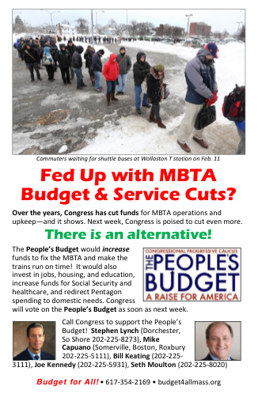
Budget Issues Are Grassroots Issues
The People's Budget connects multiple progressive constituencies
The FY2016 People’s Budget received 96 votes yet is not taken seriously by the media - so we have to organize our own campaign
We need to break down the budget and bring it to the grassroots
We campaign on the PB all year around

Slide 43
Why a People's Budget Campaign?
Activate the progressive grassroots on a comprehensive cross-issue platform
Link the PB to campaigns over component issues (for ex, debt-free college; climate change; military appropriations; shutdown threat)
Build bridges between social justice movements, promote cross-movement solidarity and collaboration
Make the PB a serious "player" each year; Increase Congressional support for the PB in annual vote

Slide 44
Upcoming Actions
March to Stop Trump’s Death Budget Cuts – May 31st in Boston
11:30 am at Tip O’Neill Federal Bldg 10 Causeway St Boston
https://actionnetwork.org/events/stop-trumps-death-budget
Targeted Congressional Visits
https://actionnetwork.org/event_campaigns/peoples-budget-congressional-visits
Lobby Training – How to Lobby Effectively on The People’s Budget
Date TBD
Visit the People’s Budget Campaign page for an updated list of actions
https://actionnetwork.org/campaigns/fy2018-peoples-budget-campaign

Slide 45
How to organize for the People's Budget
Bring more national organizations into the People's Budget Campaign
Subject matter is complicated: Communication and research resources are important
Online campaigning: Link the People’s Budget to topical issues throughout the year
Move more progressive Democrats to support the budget who have not yet done so
  Target gettable reps who can be moved
  Build a local coalition to campaign for the member's attention
  Link federal budget issues with locally resonant issues in those districts

Slide 46
Can You Visit/Call These Reps?
Rep. Terry Sewell(AL07)
Rep. Tom O'Halleran (AZ01)
Rep. Jackie Speier (CA14)
Rep. Julia Brownley (CA26)
Rep. Brad Sherman (CA30)
Rep. Norma Torres (CA35)
Rep. Raul Ruiz (CA36)
Rep. Jared Polis (CO02)
Rep. Rosa DeLauro (CT03)
Rep. Lois Frankel (FL22)
Rep. Stanford Bishop (GA02)
Rep. Colleen Hanabusa (HI01)
Rep. Tulsi Gabbard (HI02)
Rep. Dave Loebsack (IA02)
Rep. Bobby Rush (IL01)
Rep. Cedric Richmond (LA02)
Rep. Joseph Kennedy (MA04)
Rep. Seth Moulton (MA06)
Rep. Matt Cartwright (PA17)
Rep. Jim Langevin (RI02)
Rep. Beto O’Rourke (TX16)
Rep. Joaquin Castro (TX20)

Slide 47
Can You Visit/Call These Freshmen Reps?
Rep. Ro Khanna (CA17)
Rep. Jimmy Panetta (CA20)
Rep. Salud Carbajal (CA24)
Rep. Nannette Barrigan (CA44)
Rep. Lou Correa(CA46)
Rep. Lisa Rochester Blunt(DE01)
Rep. Al Lawson(FL05)
Rep. Stephanie Murphy(FL07)
Rep. Darren Soto(FL09)
Rep. Val Demmings(FL10)
Rep. Charlie Crist (FL13)
Rep. Raja Krishnamoorthi (IL08)
Rep. Brad Schneider (IL10)
Rep. Anthony Brown(MD04)
Rep. Carol Shea-Porter(NH01)
Rep. Ruben Kihuen(NV04)
Rep. Thomas Suozzi(NY03)
Rep. Dwight Evans (PA02)
Rep. Vicente Gonzalez(TX15)
Rep. Donald McEachin (VA04)

Slide 48
When will the People’s Budget be Voted On?
The People’s Budget was released on May 2nd
The President’s Budget was released on Tuesday
We expected the Ryan budget to be submitted for mark-up when Congress returned from recess; there will be a delay

Slide 49
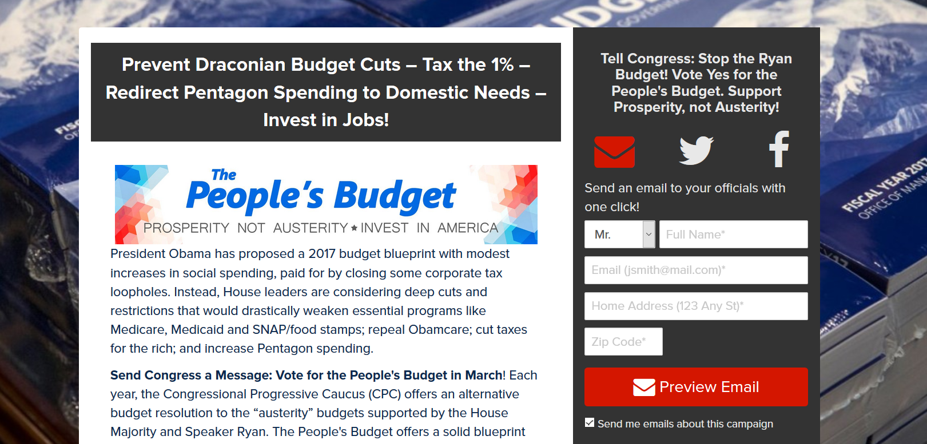
Next Steps - Working with Congress
Currently there are at least 24 organizations circulating petitions on the FY2018 People’s Budget
Future Actions
Email your House Member and ask them to support The People’s Budget
Call your House Member and ask them to support The People’s Budget

Slide 50
Working with Congress
Participate in the Mega-Petition
  24 participating organizations
  117,000 people have signed on to become a Citizen Cosponsor of The People’s Budget

Slide 51
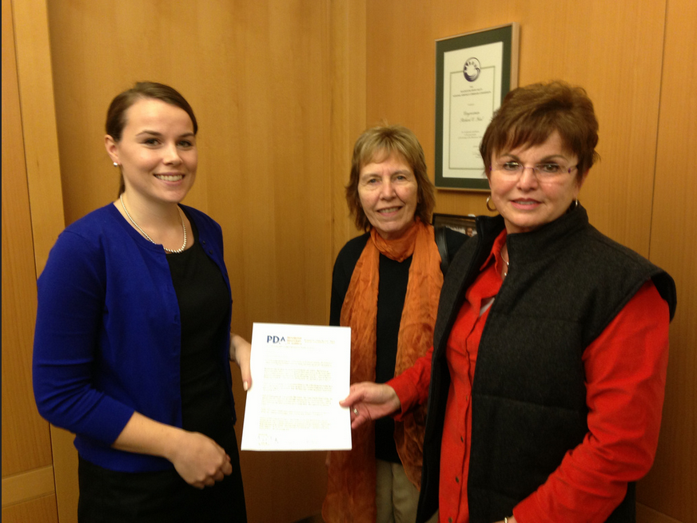
Working with Congress
Deliver a letter to your House Member asking them to support The People’s FY 2018 Budget
PDAction/PDA delivered 48 letters on Capitol Hill and 27 In District letters.
https://actionnetwork.org/event_campaigns/peoples-budget-congressional-visits

Slide 52
Informing Your Community
Write a Letter to the Editor - http://www.peoplesbudget.org/index.php/advocacy#newmode-embed-329-382
Share our Blog Posts from Daily Kos, Huffington Post and Common Dreams
Join our Thunderclap and help spread the word – Need New Link
Host a Town Hall Meeting (for FY2018 People’s Budget) – Summer
Find Resources at: http://www.peoplesbudget.org

Slide 53
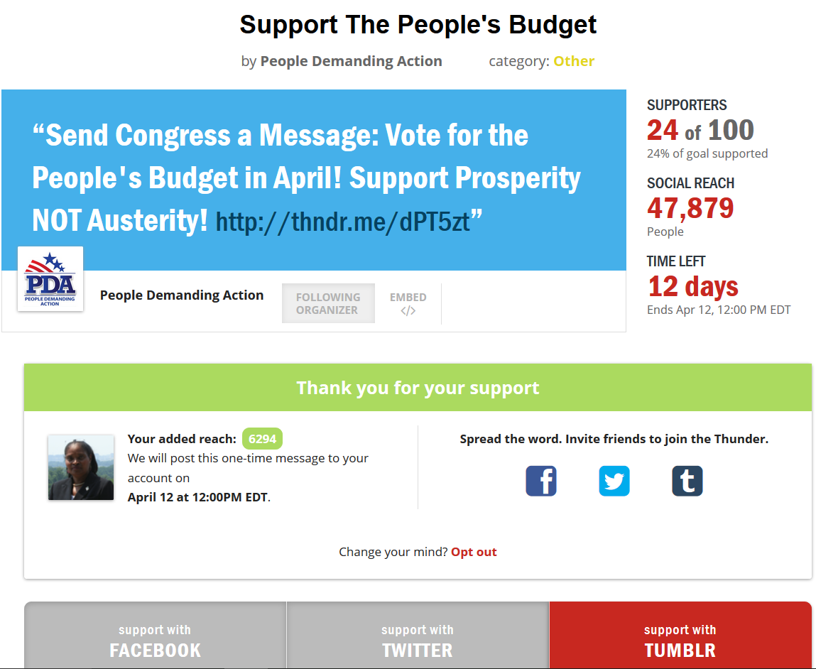
Join Our Thunderclap
Bank your Facebook, Twitter and Tumblr followers.
Thunderclaps send a single message to everyone’s Facebook, Twitter and Tumblr followers at the same time.
Our Thunderclap action will ask people to email and call their House Members and ask them to vote Yes on the FY2018 People’s Budget.

